Slide 1
Applications of ML and AI: How might they reduce disparities?
Mark R. Cullen M.D.
Causal Symposium
March 26, 2019

Slide 2
Evidence that social and environmental disparities contribute most of the variation

Slide 3
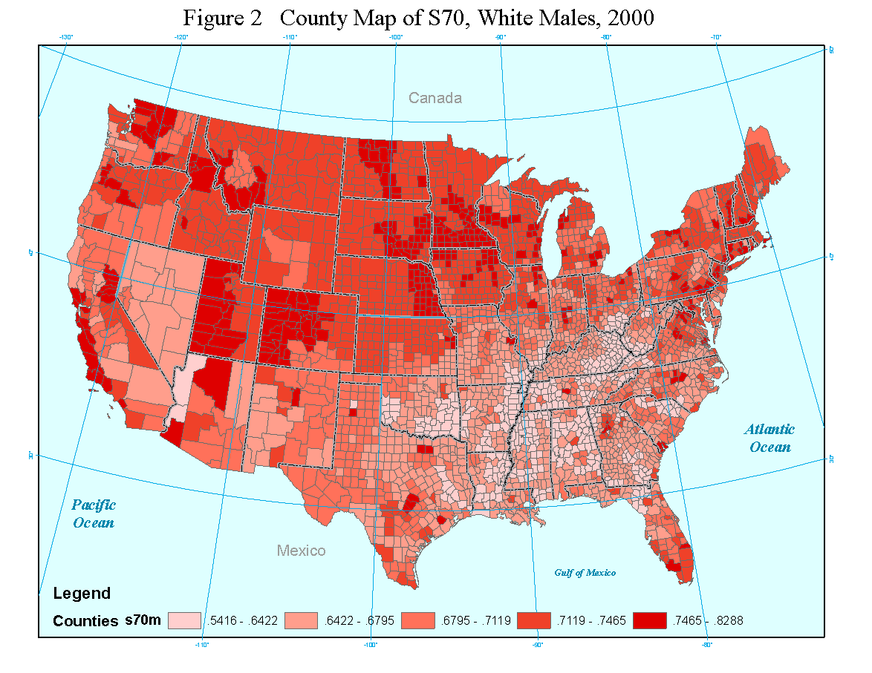
Survival to Age 70 (S₇₀) for White Male Pop. in 2000,
by county

Slide 4
Frequency distribution (kernel plot) for S₇₀
Notes:
Figure 3: Frequency distribution (kernel plot) for S₇₀. Frequency distribution (kernel plot) of survival to age 70 county for each subpopulation, 1999-2001

Slide 5
Personal SES Variables
Construct | Variable | Data Source | Metric
Low educational attainment | Education <12 years | Census | % of subgroup *10⁻²
High educational attainment | Education >12 years |  | % of subgroup *10⁻²
High occupational attainment | Managerial or professional job |  | % of subgroup *10⁻²
Income | Household income per adult equivalent |  | Mean (Household income in$/adult equivalents) *10⁻³
Poverty | Under the poverty line |  | % of subgroup *10⁻²
Wealth (property) | Log of property value |  | Mean log (property value/5X10⁴) among homeowners
Homeownership | Homeowner |  | % of subgroup *10⁻²
Wealth (property) distribution | Gini coefficient on property values |  | Coefficient between 0 and 1
Immigrant status | Not a US citizen |  | % of subgroup *10⁻²
Living without a partner | Divorced, separated or never married |  | % of subgroup *10⁻²
Notes:
Table 1: Predictor variables, sources, names and metrics for each county

Slide 6
County Level Environmental Variables
Construct | Variable | Data Source | Metric
Between race disparity in (property) wealth | Mean Black/Mean White property value | Census | Sex-specific quotient
Urban county | Metro by census definition |  | Dummy (yes/no)
Part urban | Part metro by census definition |  | Dummy
In the south | Southern by census definition |  | Dummy
Population growth rate | Population growth rate between 1990-2000 |  | %change X10⁻²
Proportion of county population that is black | Proportion of adults self-reported as black |  | % *10⁻²
Black population in surrounding area | Proportion of adults in the State, excluding county, that is black |  | % *10⁻²
Availability of fast food | Proportion of food sales classified as from limited service establishments | Economic census | % sales *10⁻²
Quality of acute care | Proportion of acute MI patients getting beta-blockers | Ref | % hospitals* 10⁻²
Cold climate | Mean January temperature
 |  |  | Degrees F*10⁻²
Warm climate | Mean July temperature |  | Degrees F*10⁻²
Air pollution | County mean conc. of fine particulate PM_{2.5} | EPA website | PM_{2.5} in mg/M³
Notes:
Table 1: Predictor variables, sources, names and metrics for each county

Slide 7
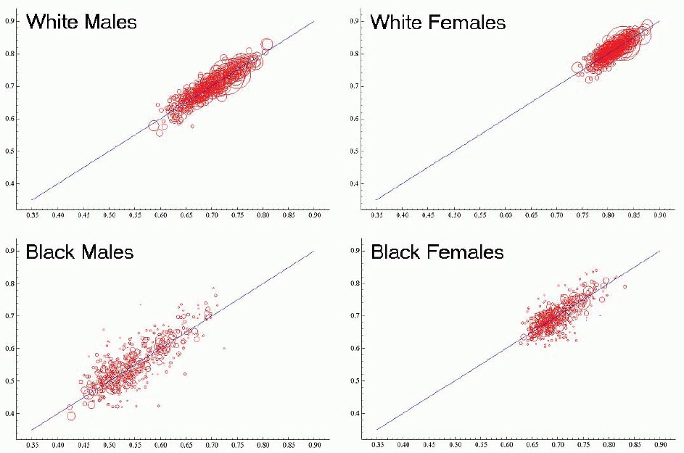
Actual and predicted S₇₀

Slide 8
Percent of counties with actual & predicted race differences in S₇₀
Men
Notes:
Figure 7A: Percent of counties with actual and predicted race differences (black-white) in S₇₀ for men. Red and blue bars represent percent of counties (N=510) with actual and predicted race differences (black-white) in S₇₀ for men. The green bars on each panel represent the hypothetical black-white difference in predicted S₇₀ if blacks in each county were assigned the comparable white value for each predictor variable.

Slide 9
Percent counties with actual & predicted race differences in S₇₀
Women
Notes:
Figure 7B: Percent of counties with actual and predicted race differences (black-white) in S₇₀ for women. Red and blue bars represent percent of counties (N=510) with actual and predicted race differences (black-white) in S₇₀ for women. The green bars on each panel represent the hypothetical black-white difference in predicted S₇₀ if blacks in each county were assigned the comparable white value for each predictor variable.

Slide 10
Evidence that healthcare disparities contribute
Differential access
Differential quality
Differential quality of evidence for treatment decisions
Differential adherence
Differential efficacy of those interventions adhered to

Slide 11
Innovative technologies and social inequalities in health: Daniel Weiss1,2*, Håvard T. Rydland3¶, Emil Øversveen3¶, Magnus Rom Jensen4, Solvor 8 Solhaug4, Steinar Krokstad1,2

Slide 13
Issues to Anticipate

Slide 14
Differential cost and access
Benefits of many advances—including those in gene-directed cancer meds—may be inaccessible to many due to cost of care and insurance differences
There is evidence that many ethnic groups are less willing to accept technologies or guidance they may confer

Slide 15
Intrinsic Biases baked into predictive algorithms
Algorithms, like genetic testing, are far more likely to be based on participation of Caucasians and higher SES subjects, hence invariable less precise for underserved, and arguably more biased
Access to the benefits of AI may be unfairly distributed
Even when there is access, some social and ethnic groups are less willing to accept technologies or guidance they may confer, or willing/able to afford them
Algorithms that predict bad outcomes—hence suggest withholding aggressive treatment—likely incorporate social determinants, parlaying risk into destiny

Slide 16
How are we doing at Stanford?
Apple Heart
PHIND
Center for Precision Health and Wellness

Slide 17
How are we doing at Stanford?
The Green Button
Determination of treatment benefit for prostate cancer (VA)

Slide 18
How are we doing at Stanford?
Cohort filtering models to identify social program effects on health disparities
Our Voice
PretermConnect
Aqua

Slide 19
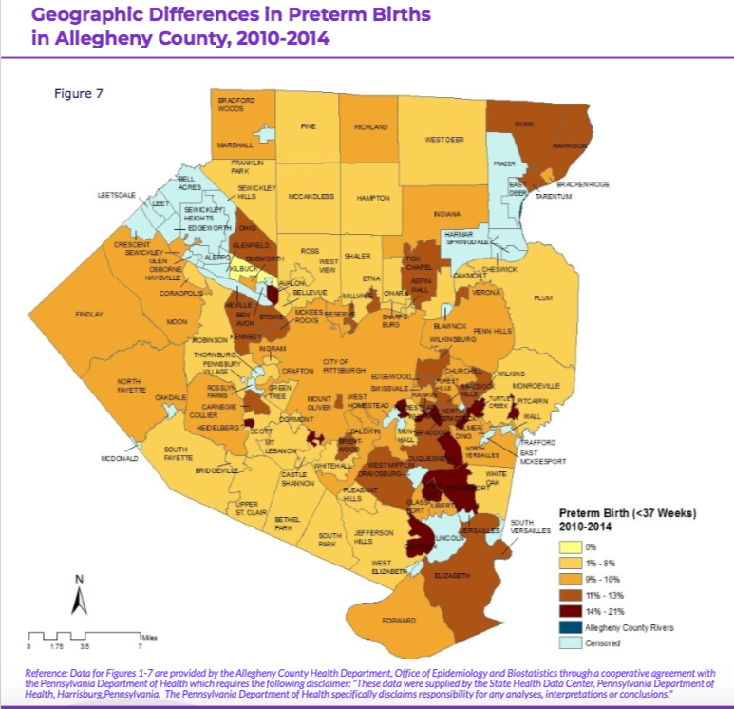
Addressing disparities of preterm births among districts of Allegheny County, PA
Some target areas with high rates of PTB:
East Pittsburg: Wilkinsburg and Hazelwood
Mon Valley: Braddock, Duquesne, and McKeesport
Communities in west side of Allegheny: McKees Rocks
Healthy Equity Brief Maternal and Child Health in Allegheny County, 2018
Notes:
Topic: We utilized Allegheny County Health Department information to understand more about the areas of need within Allegheny County.
The information on this slide came from Allegheny County Health Department (ACHD)
Map: geographic areas most affected by preterm birth
East Pittsburg: Wilkinsburg and Hazelwood
Mon Valley: Braddock, Duquesne, and McKeesport
Communities in west side of Allegheny: McKees Rocks
We can use known information on areas with higher rates of preterm birth to target participant recruitment.
Infant Mortality Rates
2015 measurement period: 6.6 deaths/1000 live births in Allegheny County, compared to Pittsburgh municipality rate of 8.0 deaths/1000 live births
https://www.alleghenycounty.us/Health-Department/Resources/Data-and-Reporting/Chronic-Disease-Epidemiology/Allegheny-County-Community-Indicators.aspx?hcn=%2Findicators%2Findex%2Fview%3FindicatorId%3D4375%26localeId%3D2297%26comparisonId%3D7209%26hcnembedredirect_%3D1?hcn=
Transition: While we will work to address PTB rates throughout all of Allegheny County, we will specifically target areas of higher need to distribute PretermConnect. We aim to address some of the objectives from the Plan for a Healthier Allegheny County (PHA).
Map: https://www.alleghenycounty.us/uploadedFiles/Allegheny_Home/Health_Department/Resources/Data_and_Reporting/Chronic_Disease_Epidemiology/HEB-MCH.pdf

Slide 20
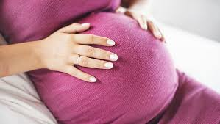
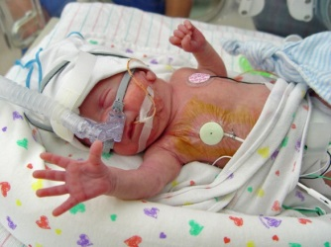
Research through PretermConnect
Hypothesis:
Engaging mothers with a mobile app will improve risk prediction (via patient-generated data), care coordination and mothers’ adherence to recommended care, with the ultimate effect of reducing preterm births and infant mortality.
Notes:
Research Question:
Can a mobile health strategy be used to reduce spontaneous PTB via improved patient engagement, care coordination, and adherence to recommended care?
Beyond this question, we want to understand engagement. Engagement requires the inclusion local stakeholders for relevance, impact, and better outcomes, we can discuss later in this discussion.
Image
Group of moms
https://www.google.com/url?sa=i&source=images&cd=&cad=rja&uact=8&ved=2ahUKEwjWn92vgdncAhXKiVQKHe9MARAQjhx6BAgBEAM&url=https%3A%2F%2Fwww.workingmother.com%2Fmessage-to-stay-at-home-moms-thanks-for-saving-my-butt&psig=AOvVaw2GBPdsIpA4TpjlPCiSDUhT&ust=1533664925819939

Slide 21
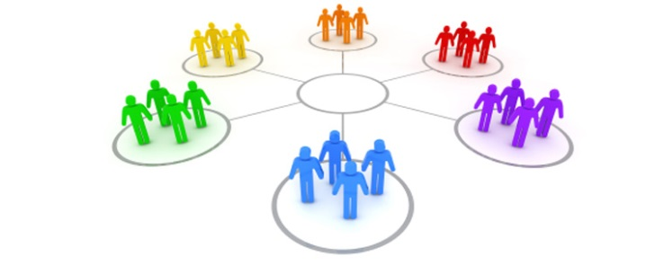
Partners in County-wide Data Integration Project for Preterm Birth
Current Partners
Proposed?
Suggestions?
Notes:
Our current partners include, we are excited to work with all of you to create a sustainable, impactful change in decreasing PTB in AC and beyond.
Current partners
R.K. Mellon Foundation
March of Dimes
Lucile Packard Children’s Hospital (Family Advisory Council)
Other proposed partners (from their perspectives)
Image: https://www.google.com/url?sa=i&source=images&cd=&cad=rja&uact=8&ved=2ahUKEwie16PvtL3cAhWrw1QKHSn_BD8Qjhx6BAgBEAM&url=https%3A%2F%2Fblog.commlabindia.com%2Felearning-design%2Fdealing-with-difficult-elearning-stakeholders&psig=AOvVaw0zmLTPiQbEaeRKyz49kt5n&ust=1532716690868256

Slide 22
Solano County
A Population-Based Analytic Resource (sandbox)
Bela Matyas, MD, MPH
Solano County Public Health Officer
Mike Stacey, MD, MPH
Deputy Director Health and Social Services
Dan Desmond, HIT, public health informatician
Goal: Create an analytic sandbox comprised of longitudinal EHR records for residents of Solano county, to develop actionable knowledge that will . . .
enhance public health monitoring & prevention
improve healthcare quality and reduce costs
develop insights to inform social and healthcare policies
Notes:
Bela’s view – completely change how population health is conceptualized and how it works
Be bold – if we cannot envision it happening, it won’t happen

Slide 23
Goal: Northern California’s First Regional Health Information Exchange
Del
Norte
Siskiyou
Modoc
Trinity
Shasta
Lassen
Humboldt
Tehama
Plumas
Mendocino
Glenn
Butte
Sierra
Colusa
Yuba
Nevada
Placer
Lake
Sutter
Sonoma
Napa
Yolo
El Dorado
Sacramento
Amador
Alpine
Marin
Solano
San
Joaquin
Calaveras
Tuolumne
San Francisco
Contra Costa
Mono
Alameda
Stanislaus
Mariposa
San Mateo
Santa Clara
Merced
Santa Cruz
Madera
San Benito
Fresno
Inyo
Monterey
Kings
Tulare
San Luis Obispo
Kern
Santa Barbara
San Bernardino
Ventura
Los Angeles
Orange
Riverside
San Diego
Imperial

Slide 24
Solano County PPHub Schema
Health Systems
Solano County
Population and Public
Health Hub
Immunization
Link with flu data
Hospitals
Provider
Network
Cancer Cases
CA registry, SEER
FQHC, DoD
& VA
Electronic Lab
Reporting
State Helaht Dept
HIE
Interface
CDC
Individual Practices
Childhood
Lead
Clinical
Laboratories
RASSCLE
Syndrome
Surveillance
Public Health
CDC
Non-Commuicable Diseases
Notes:
Complicated figure I know, will try to point out some uses for the data as I explain.
Single pipeline from each provider. Move data through router; can go back to source of data as needed.
At HIE interface, QA, standardization and de-duplification is carried out (proprietary by SIMI). Has to handle ELRs – 27 standards from CDC (all supported)
Some lab are sending 732 data elements per test – patient, NOK, timing sequence, lab (costs less to send all data elements)
In Solano, providers are varied – have currently worked out all but Kaiser and Sutter, coming on in next couple of months.

Slide 25
Thank you!

